Slide 1
History on gaa
By emma jane

Slide 2
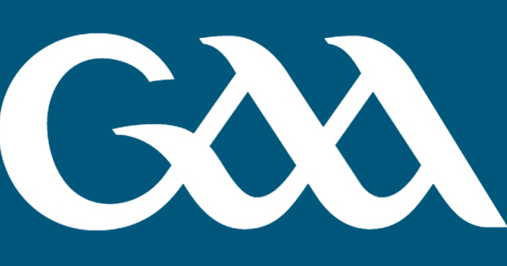
What is GAA
The Gaelic Athletic Association (GAA) is Ireland’s largest sporting organisation. It is celebrated as one of the great amateur sporting associations in the world.
It is part of the Irish consciousness and plays an influential role in Irish society that extends far beyond the basic aim of promoting Gaelic games

Slide 3
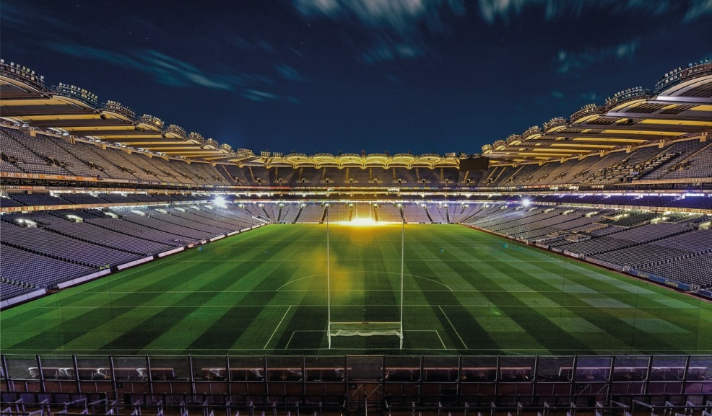
Where is it played
The main stadium is Croke Park which holds 82,000
In Páirc Uí Chaoimh in Cork which holds 45,000
In Perse Stadium which holds 26,000
And our local stadium O’Moore which 22,000

Slide 4
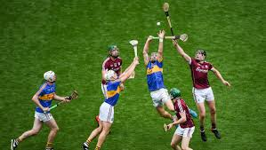
Hurling
is an outdoor team game of ancient Gaelic Irish origin. The game has prehistoric origins, and has been played for 4,000 years
One of Ireland's native Gaelic games, it shares a number of features with Gaelic football , such as the field and goals, the number of players, and much terminology.
It shares a common Gaelic root with the sport of shinty, which is played predominantly in Scotland.

Slide 5
What you need for hurling/football
Hurling
Football
You need
a hurl
Hurling boots
Sliotar
A helmet
Togs ,socks and a jersey
A team of 30 players
A field
A captain
A manager
First aid
You need
Gum shields
Football boots
Football
Togs ,socks and a jersey
A team of 30 players
A field
A captain
A manager and selectors
First aid

Slide 6
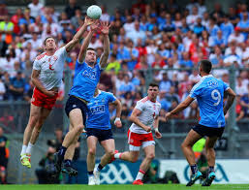
Gaelic football
commonly referred to as football or Gaelic, is an Irish team sport .
It is played between two teams of 15 players on a rectangular grass pitch.
The objective of the sport is to score by kicking or punching the ball into the other team's goals or between two upright posts

Slide 7
Thank you for listing
:]

