Slide 1
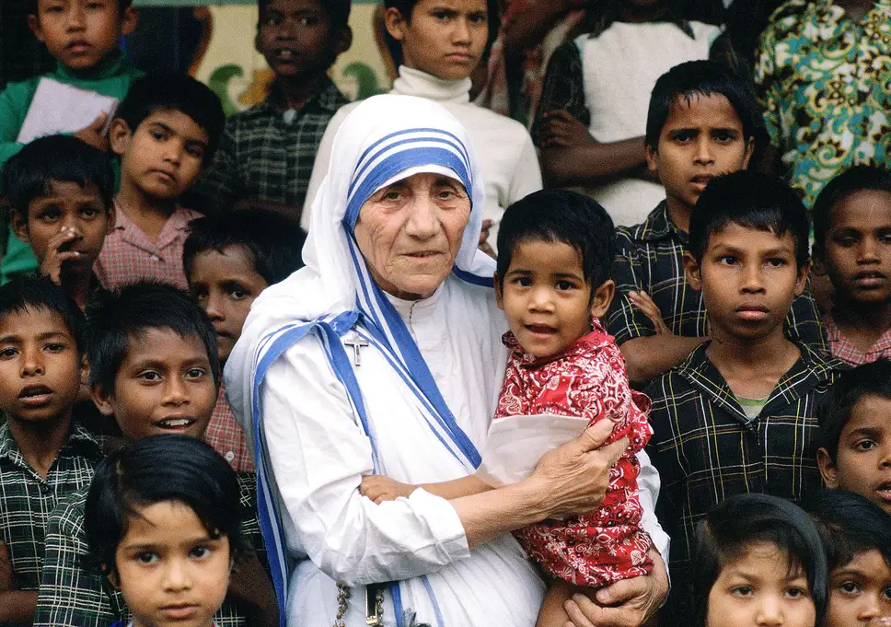
My Role Model Mother Teresa
By Chloe Lyons

Slide 2
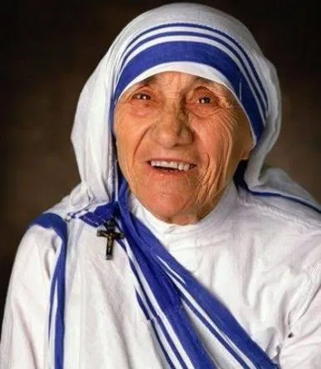
When and where was Mother Teresa born?
Mother Teresa was born in Macedonia in 1928.
Mother Teresa lived in India.

Slide 3
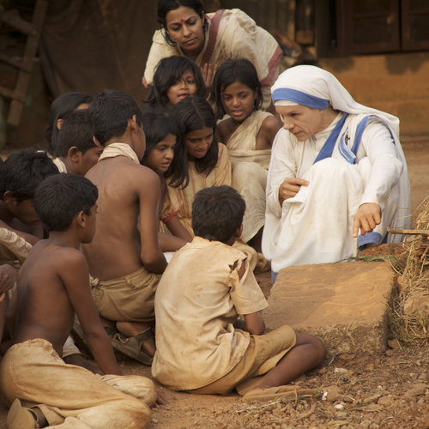
What was Mother Teresa Most Famous for?
She formed a religious order in Calcutta, India, called the Missionaries of Charity.
The nuns fed the poor and ran hospitals, schools and orphanages.

Slide 4
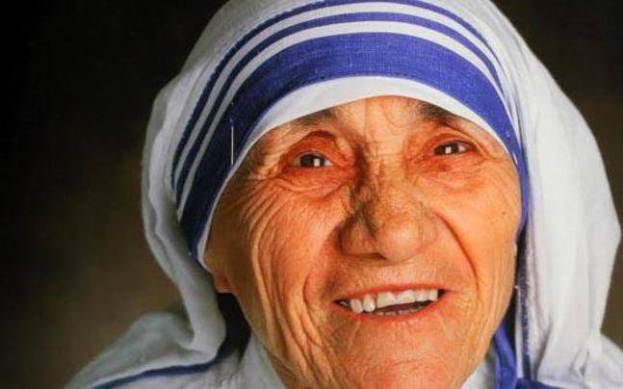
Famous quote said by Mother Teresa
“Peace begins with a smile”
“There are no great things, only small things with great love, happy are those”

Slide 5
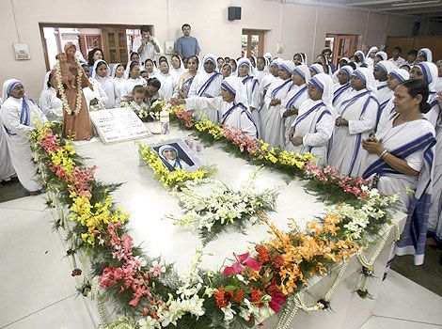
Where and when did Mother Teresa die?
Mother Teresa died on the fifth of September 1997 Calcutta, India, aged 87.
Her tomb is in the Mother House at the Missionaries of Charities convent in Calcutta.

Slide 6
Why I chose Mother Teresa as my Role Model!
Mother Teresa liked to help people, I enjoy helping people also.
She worked with children in schools, orphanages and hospitals. Some day I would like to become a teacher.
She was nice to people, I always try to be nice.
She treated everybody equally. In her eyes we are all the same and deserve to be treated as equals.
I really admire Mother Teresa

